Slide 1
Reduced Order Thermokarst Initiation Models With Random Forests
Rawser Spicer

Slide 2

Committee
Dr. Orion Lawlor
Dr. Bob Bolton
Dr. Glenn Chappell

Slide 3
Goal
Can a reduced order model be built from the Alaska Thermokarst motel’s (ATM) thermokarst initiation model the has similar results to the full model, but with fewer inputs.
Notes:
OR
Can we determine which inputs/factors to the thermokarst initiation model are most important, and develop a model based on those that produces results similar to the original model.
What is a reduced order model?
-- Reduce complexity in models to gain increases in speed at runtime

Slide 4
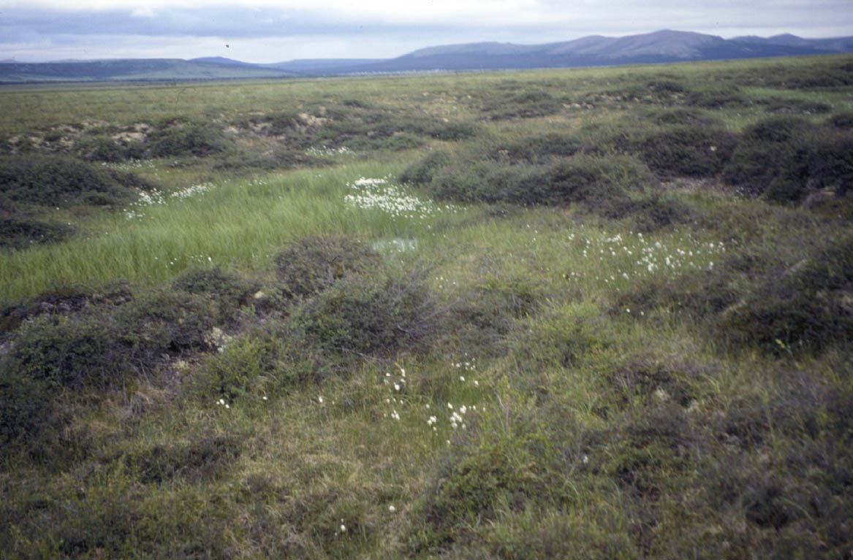
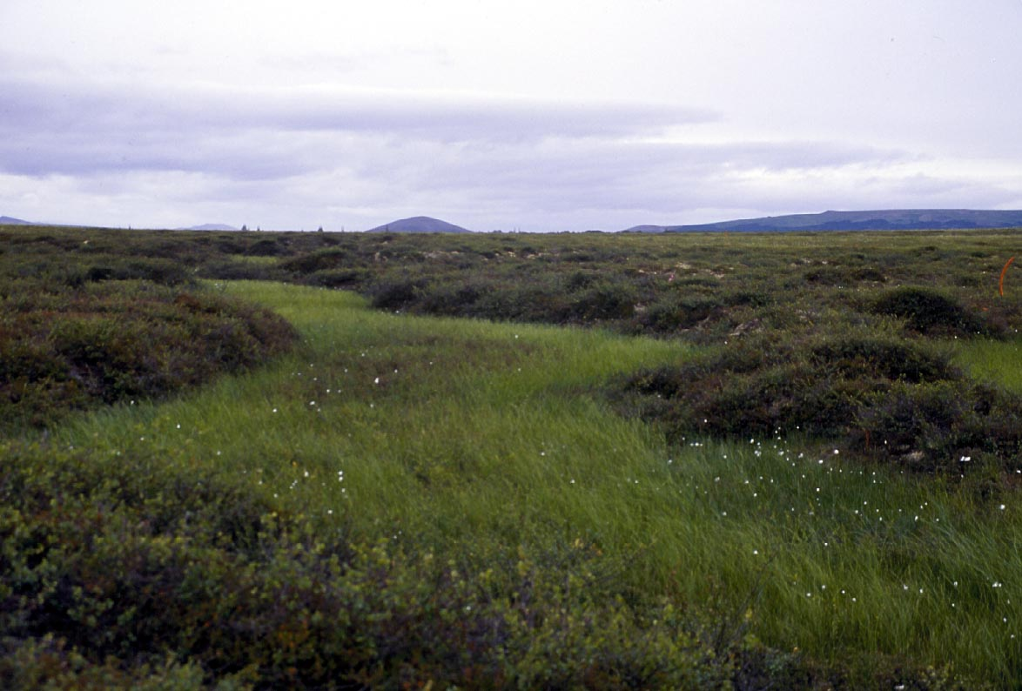
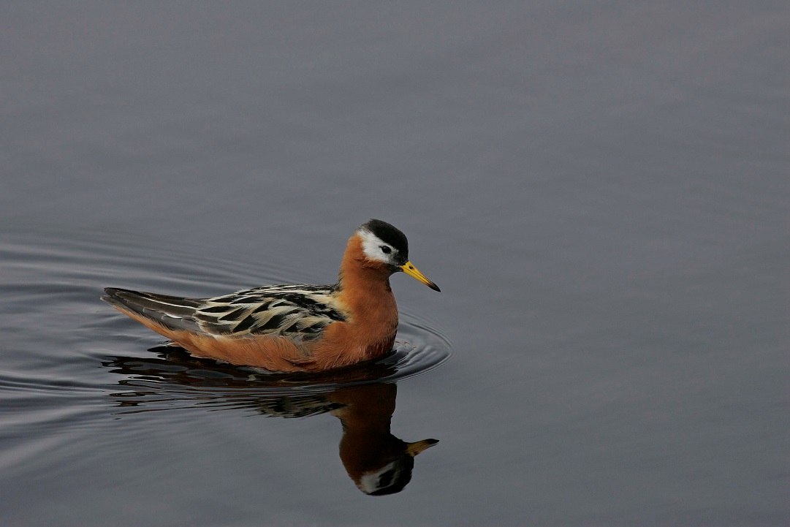
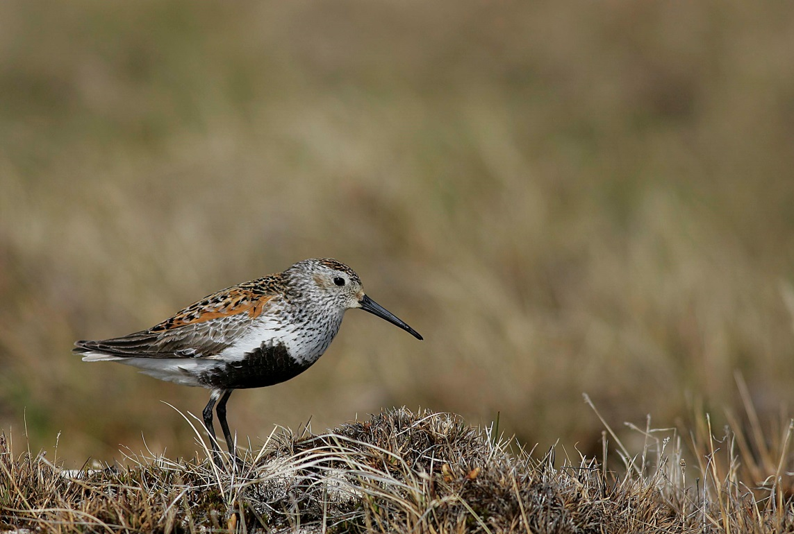
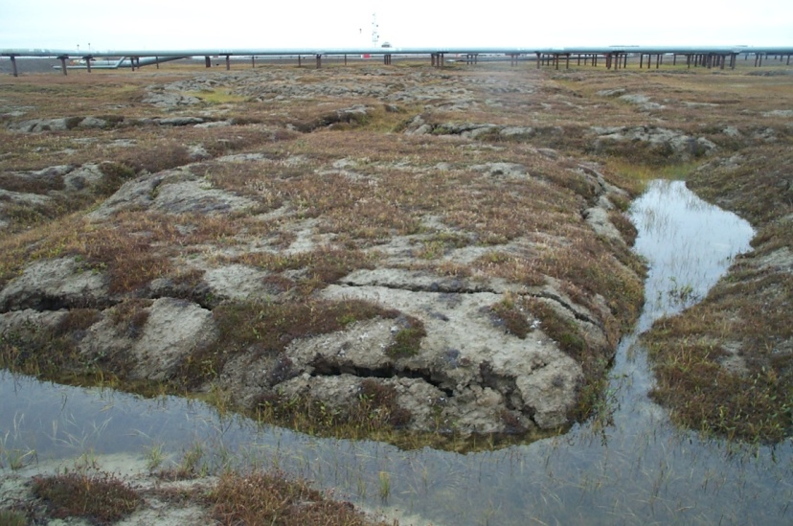
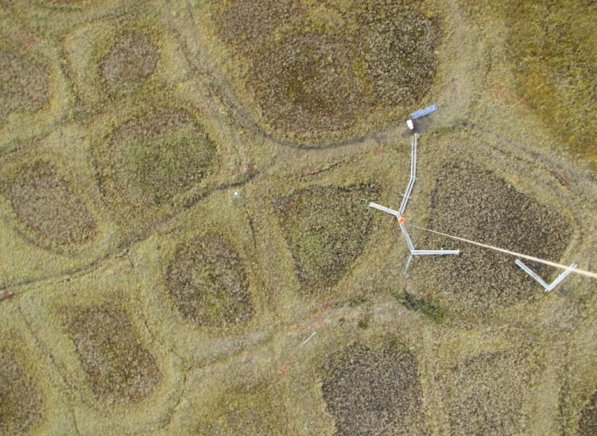
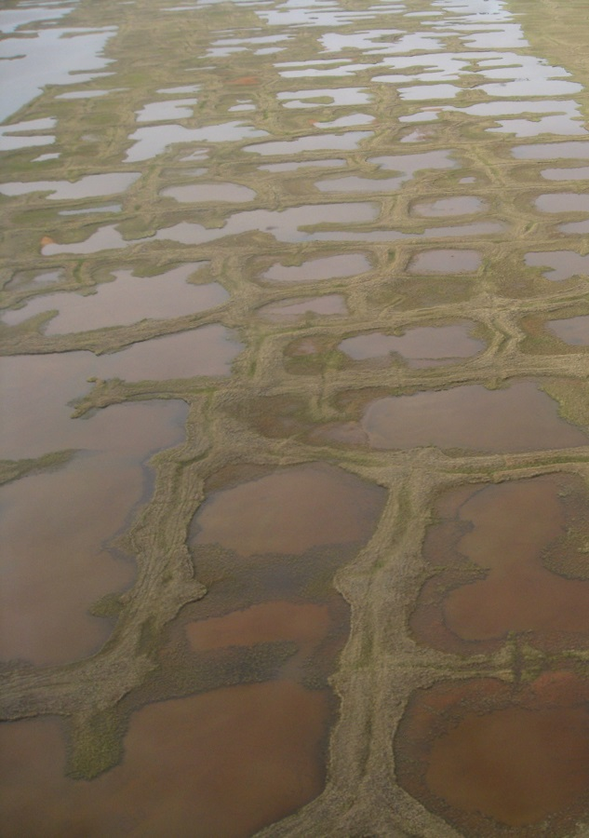
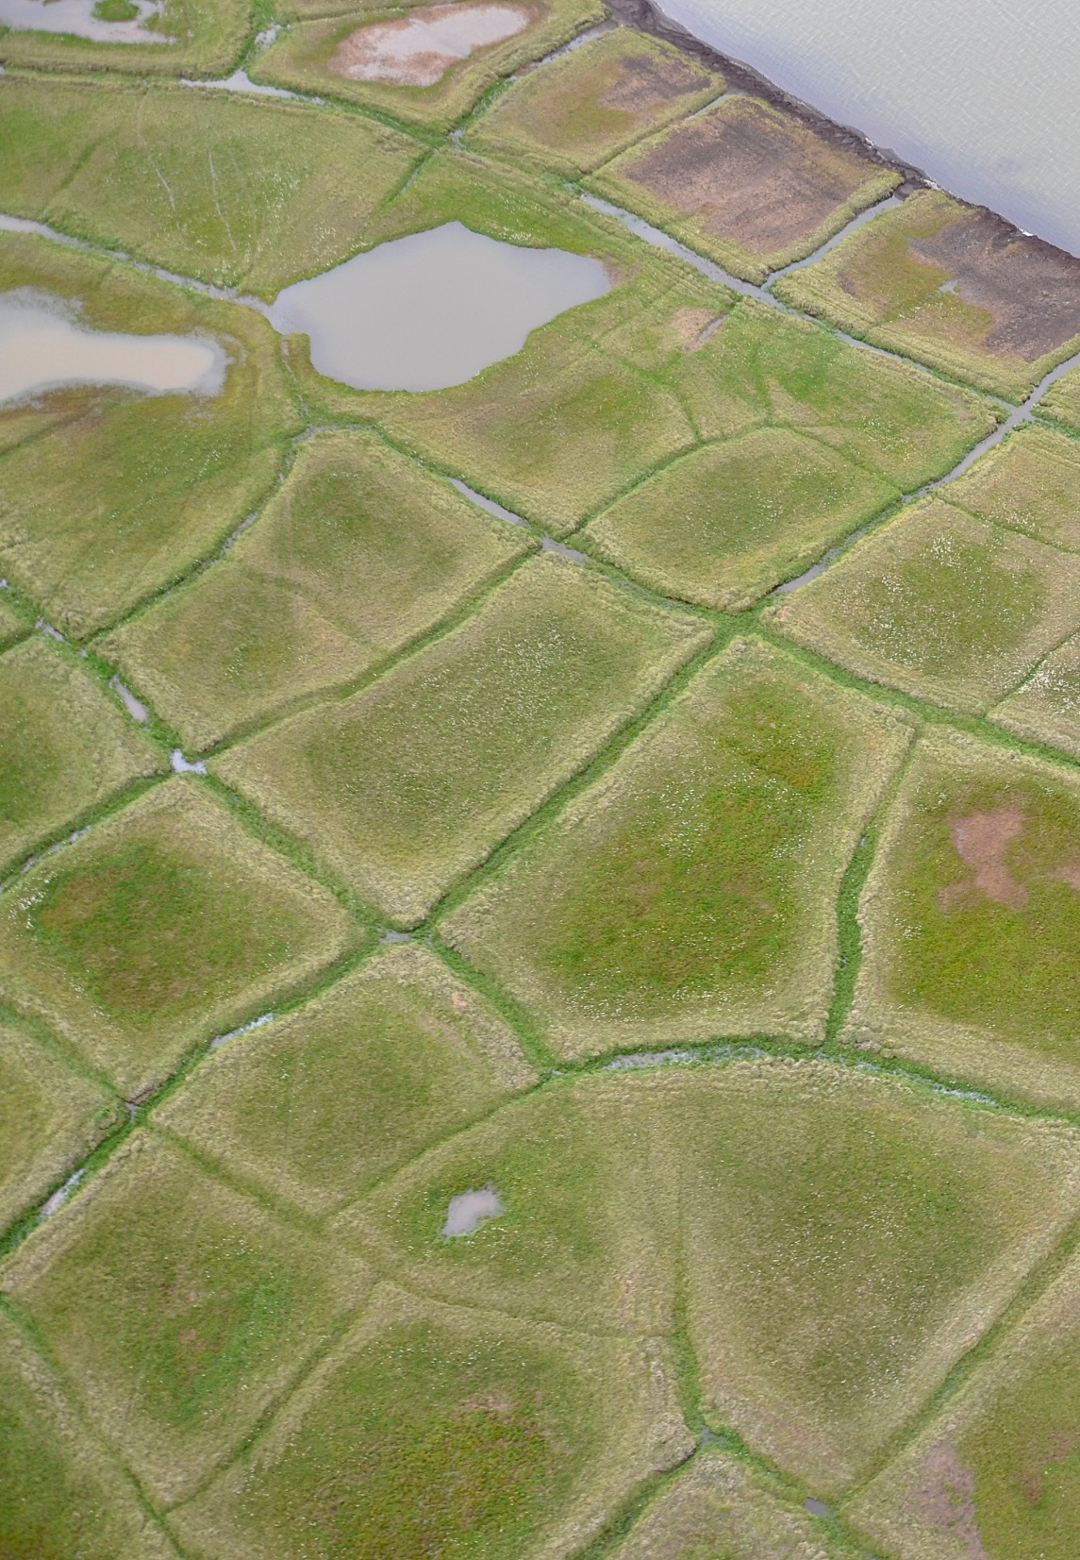
Background
A: Vegetation
B: Wildlife
Understanding thermokarst initiation and resulting changes to arctic landscape are important to understanding changes in vegetation, wildlife, drainage patterns, and the carbon & energy regimes. These changes are at the intersection of climate, ecosystem, hydrology and permafrost sciences, and are important to wildlife managers and development projects amongst others.
Philip Martin
Philip Martin
C: Drainage
Lawrence Berkeley Nat'l Lab –
Roy Kaltschmidt, photographer
Image courtesy of Julia Boike
D: Energy Regime
Q_{e}
CH₄
Q_{h}
CO₂
Q_{h}
CO₂
Q_{e}
CH₄
Notes:
Who is this useful to?
wild life management
Where do the ducks go in winter
Changes in vegitation
construction projects
Where to build a well
other modeling projects (E3SM)
Cannot currently transition their ‘landcover state’ from wet to dry or vice versa.
This has inpacts on the carbon and energy fluxes that influence the model
E3SM is the DOE’s global climate model

Slide 5
The Alaska Thermokarst Model
Models landscape change due to changes caused by thermokarst cycle
Landscapes transition from meadows to low center polygon covered to high center polygonal cover to ponds and lakes
Landscape units (cohorts) are tracked on a gridded subdivision of the model area
Logic-based rules are used to determine when the landscape transitions from its current cohort to the next cohort
Notes:
Aims to model landscape evolution due to thermokarst cycle. A cycle that is driven by thawing permafrost.
Modeling domain is the Arctic costal plain.
Several processes are included in the model including landscape transition, and thermokarst Initiation

Slide 6
Alaska Thermokarst Model Flow Chart
Parent Cohort
[Parent Landscape (LS)] + [Parent Ecotype (ET)]
Yes
3
No
Determine LS Change
1
2
Yes
Yes
No
No
No
4
Determine ET Change
Yes
Set Protective Layer Depth
Child Cohort
[Parent LS] + [New ET]
Determine Rate of LS Change
Update Protective Layer Depth
Determine ET Change
Child Cohort
[New LS] + [New ET]
Yes
4
No
Child Cohort
[New LS] + [Parent ET]
Yes
No
4
Determine ET Change
Is the thermokarst active?
Has the thermokarst been initiated by a extreme event?
Is the active layer > protective layer?
Does climate support new ecotype?
Notes:
Several proceeses are included in the model including landscape transition, and thermokarst Initiation
Each cell is isolated, so the model is heavily parralizeable
Land form types
wetland tundra
Ecotype
Lcp,Hcp, pond, meadow

Slide 7
Project Focus
Parent Cohort
[Parent Landscape (LS)] + [Parent Ecotype (ET)]
Yes
3
No
Determine LS Change
1
2
Yes
Yes
No
No
No
4
Determine ET Change
Yes
Set Protective Layer Depth
Child Cohort
[Parent LS] + [New ET]
Determine Rate of LS Change
Update Protective Layer Depth
Determine ET Change
Child Cohort
[New LS] + [New ET]
Yes
4
No
Child Cohort
[New LS] + [Parent ET]
Yes
No
4
Determine ET Change
Is the thermokarst active?
Has the thermokarst been initiated by a extreme event?
Is the active layer > protective layer?
Does climate support new ecotype?
Notes:
The focus of my project is just on one subprocess of the ATM
The Thermokarst Initiation step
Is a change occurring

Slide 8
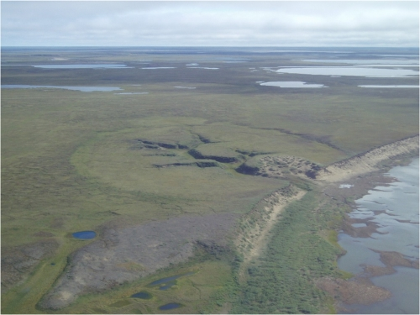
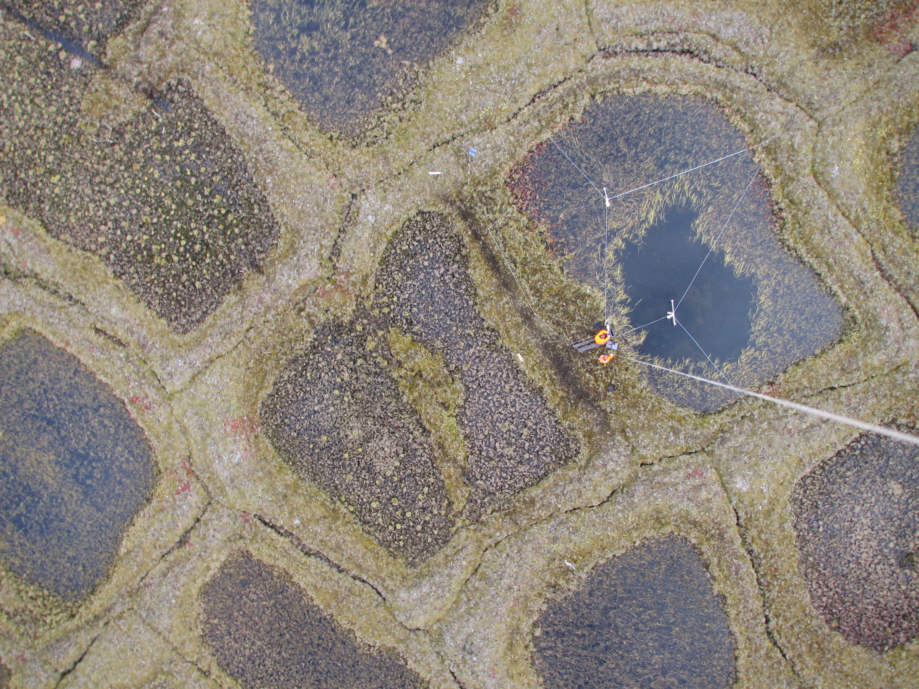
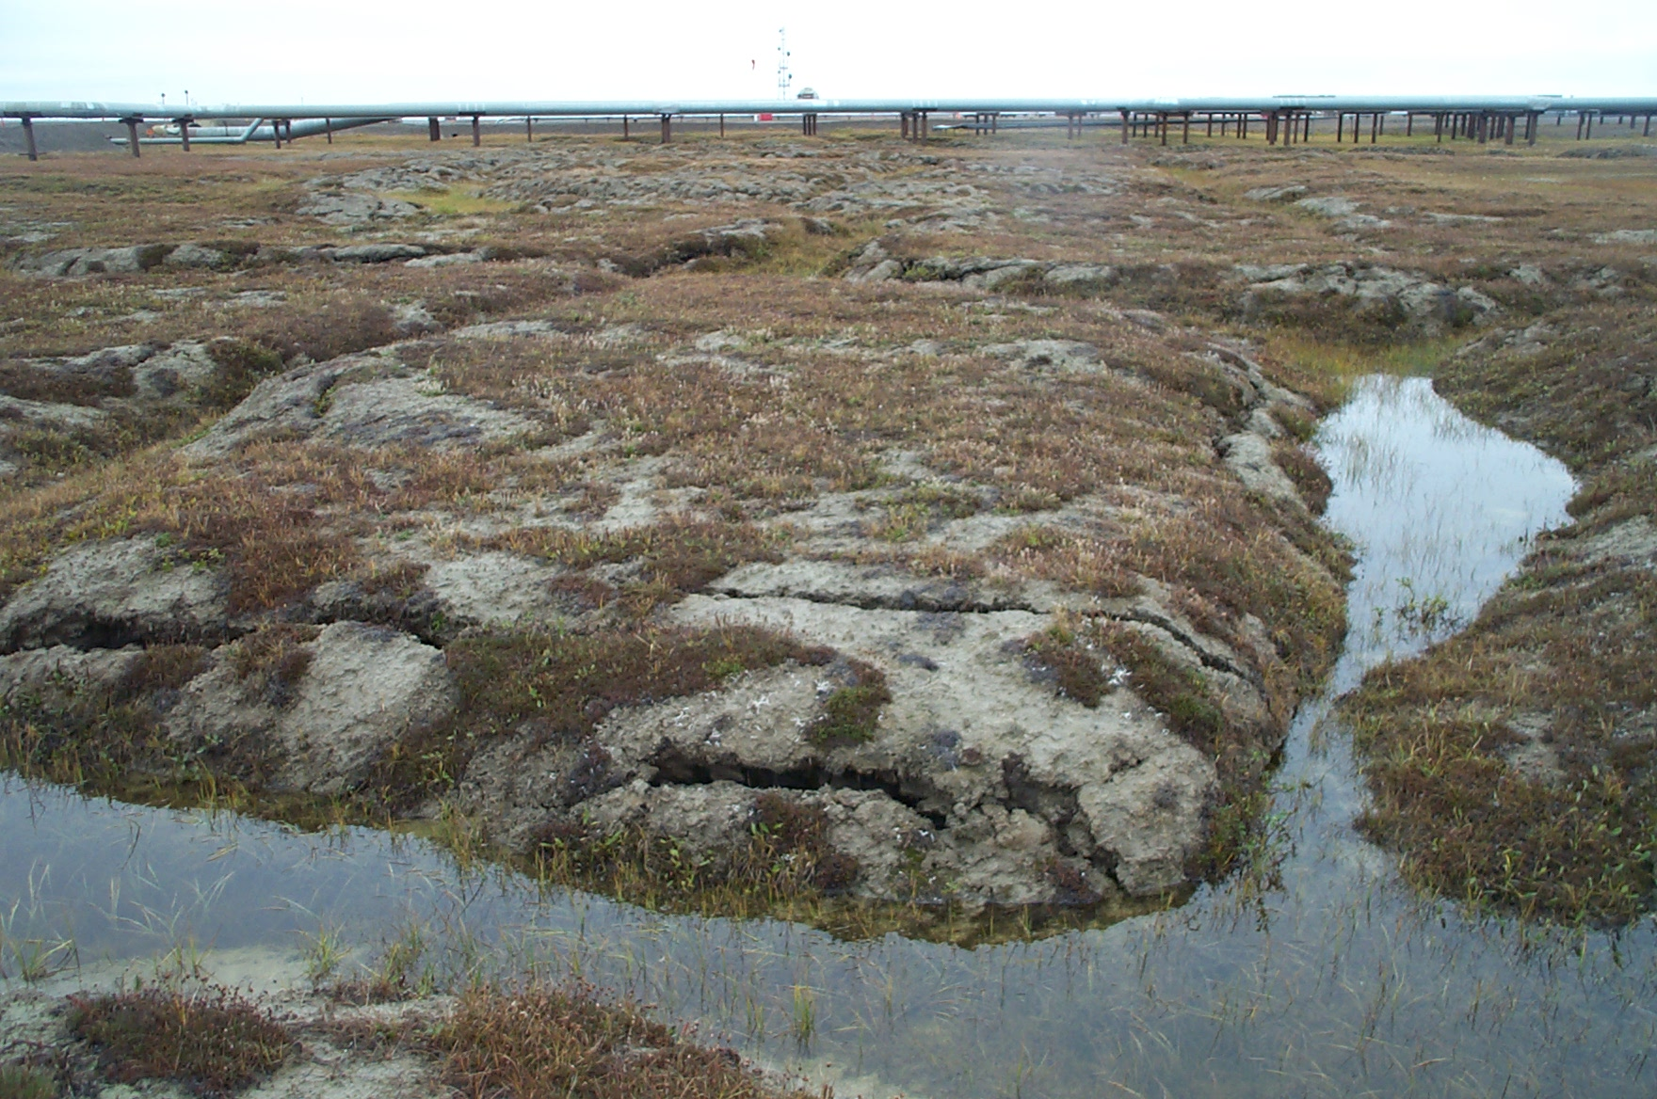
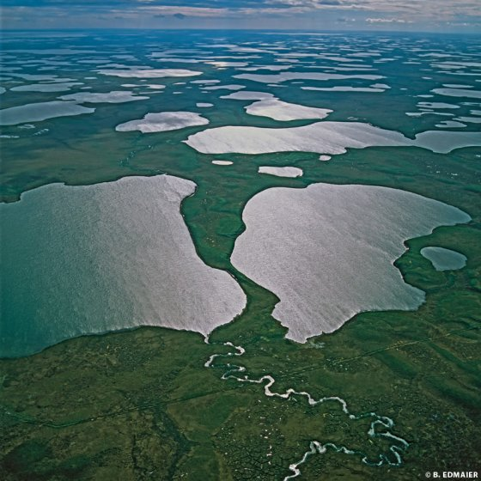
Permafrost and Thermokarst
Permafrost occurs when soils remain continuously frozen for many years.
During summers top layer permafrost thaws this is called the active layer,
active layer depth is the depth to the top of the permafrost
Thermokarst features are caused by thawing ground Ice.
Thermokarst features include polygonal patterned ground, and thermokarst lakes
Non-Polygonal Ground
Low Centered Polygon
High Centered Polygon
Lakes
B. Jones
J. Boike
L. Hinzman
IPA Website
Notes:
Permafrost soils are soils that are continuously frozen
Durring summers the top layers of the permafrost thaw forming an active layer
Plants grow there.
Called ALD or ALT
Normally refreezes in winter.
Thermokarst
see pics
npg == meadows
LCP == ice wedges pushing up soil, creates ‘tubs’
HCP == Ice wedge collapse creates troughs and ‘islands’
Lakes and ponds, troughs erode ‘islands’ creating larger ponds

Slide 9
Permafrost and Thermokarst
Non-Polygonal Ground
Low Centered Polygon
Permafrost occurs when soils remain continuously frozen for many years.
During summer the top layer of permafrost thaws this is called the active layer.
active layer depth is the depth to the top of the permafrost
Thermokarst features are caused by thawing ground Ice.
Thermokarst features include polygonal patterned ground, and thermokarst lakes
J. Boike
Lakes
B. Jones
High Centered Polygon
L. Hinzman
IPA Website
Notes:
Permafrost soils are soils that are continuously frozen
Durring summers the top layers of the permafrost thaw forming an active layer
Plants grow there.
Called ALD or ALT
Normally refreezes in winter.
Thermokarst
see pics
npg == meadows
LCP == ice wedges pushing up soil, creates ‘tubs’
HCP == Ice wedge collapse creates troughs and ‘islands’
Lakes and ponds, troughs erode ‘islands’ creating larger ponds

Slide 10
Thermokarst Initiation
What causes the thermokarst process to begin?
It is thought that thermokarst initiation is caused by extreme climate conditions.
Once thermokarst process has begun it takes 20-30 years for a landscape to stabilize
Notes:
How can we model thermokarst initiation?
What are the casues
extreme precipitation
extreme tremeratures (high)
Ones the cycle starts it lasts 20 to 30 years for changing landscape to stablize

Slide 11
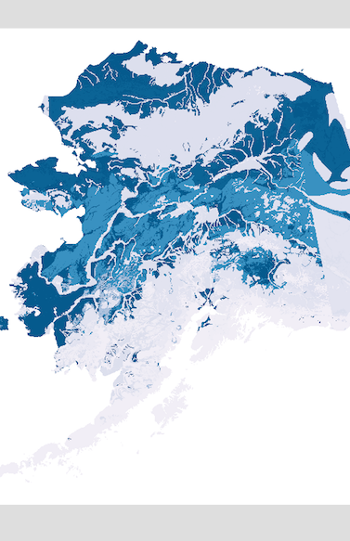
Current Method
Look for regions where the temperature and precipitation have been extremely greater than the average for a winter and into the next summer.
Based on field observations on the Seward Peninsula
Use the 1901-1950 average
Look at:
Summer temperature
Early winter precipitation (Oct-Nov)
Total winter precipitation (Oct-Mar)
Winter temperature
The following summer temperature
Data are in raster format for years 1901-2015
Combine these results with map of thermokarst predisposition.
thermokarst predisposition
Notes:
Look for areas where multiple conditions are greater than a historic average
Take the summer temp, eary winter precp, total winter precp, winter temperatures, and next summers temperature.
Ie for 1950 potential initiation, check if 1949 summer temp, ewp, fwp, fdd, and 1950 summer temp are high.
1901-1950 maintain relatively stable climate conditions
Results are also merged with a thermokarst predisposition model, as a post processing step if desired.

Slide 12
Current Method
Step 1:
For variables in [ EWP, FWP, WT, ST]:
Calculate mean for 1901-1950
Step 2:
For each year from 1901-2015:
year_thermokarst_iniation_potential = 0
For variables in [ EWP, FWP, WT, ST]:
var_diviation = ((var_in_year – var_mean) / |var_mean|) * 100
year_thermokarst_iniation_potential p += var_diviation
year_thermokarst_iniation_potential p = year_thermokarst_iniation_potential / 4
year_thermokarst_iniation_potential *= thermokarst_predisposition

Slide 13
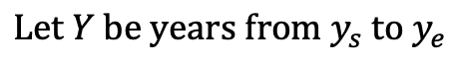
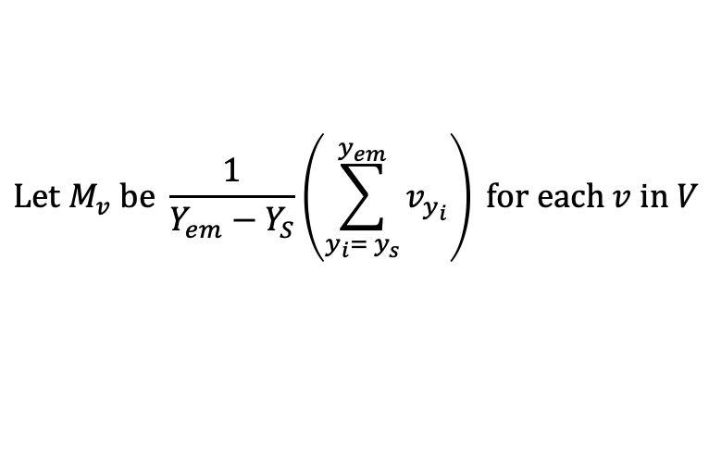
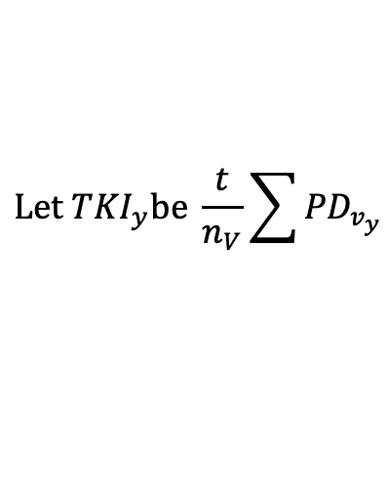
Current Method
$$L\text{et} Y \text{be} \text{years} \text{from} y_{s} \text{to} y_{e}$$
$$y_{em }∈Y \text{i}\text{s} \text{the} \text{end} \text{of} \text{the} \text{period} \text{used} \text{for} \text{calulating} \text{means}$$
$L\text{et} t \text{be} \text{thermoka}r\text{st} \text{predispositioin} \text{value} \left[0,1\right], or set as one if not applying this$
$$\text{Let} V \text{be} \text{set} \text{of} \text{variables} \text{with} \text{values} \text{for} y ∈Y$$
$$\text{Let} M_{v} \text{be} \frac{1}{Y_{em}−Y_{S}}\left(\sum_{y_{i}= y_{s}}^{y_{em}}{v_{y_{i}}}\right) \text{for} \text{each} v \text{in} V$$
$\text{Let} PD_{v} \text{be} \left\{\left(\left(V_{y}−M_{v}\right)/\left|M_{v}\right|\right)∗100 \text{for} y ∈Y\right\}\text{for} v∈V$
$$\text{Let} {TKI}_{y}\text{be} \frac{t}{n_{V}}\sum{{PD}_{v_{y}}}$$
Notes:
Y is set of years from start to end
Yem is end of mean period
T is $\text{thermoka}r\text{st} \text{predispositioin} \text{value}\text{, }\text{or}\text{ 1 }\text{to} \text{ignore}$
V is the set of variables with values for each year
M is set of means from Ys to Yem for each var
PDv is the set of percent differences from for each variable for each year
TKI is the iniation value for each variable

Slide 14
Current Method
Algorithm gives a numerical value were higher values mean higher likely hood of thermokarst initiation.
A threshold is set as the minimum thermokarst initiation value
Notes:
Threshold is undetermined

Slide 15
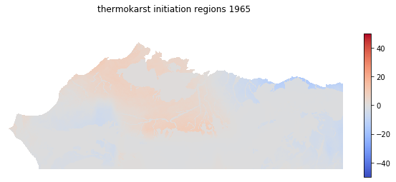
Current Method Example 1965
Notes:
Find min and max

Slide 16
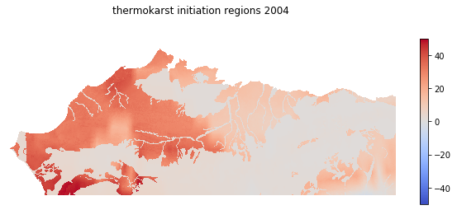
Current Method Example 2004
Notes:
Find min and max

Slide 17
Project Goals
Use random forests to determine which features are the most important variables to thermokarst Initiation, and develop a reduced order model from those
Compare new model to original model
Notes:
Compare values before and after threshold is applied

Slide 18
Random Forests
Ensemble learning method
The first algorithm for random decision forests was created by Tin Kam Ho
Further developed by Leo Breiman and Adele Cutler
Designed to correct the overfitting that may occur in regular decision tree models
Constructs multiple decision trees during training, and when testing averages the result from each tree to find the final result
Average is used when doing regression, mode when classifying
Notes:
Ensemble of decision trees
Ensemble learning method: i.e. uses multiple instances
Created by Tin Kam Ho refined by Leo Breiman and Adele Cutler, they added the bootstrap aggregating
Corretts for over fitting by…

Slide 19
Methodology for Random Forests
Train:
Train Random forest model using a subset of features that may influence prediction and predictions from the existing model.
Test:
Use the trained model to make predictions based on full set of features
Verify:
Compare random forest predictions to existing model predictions

Slide 20

Decision Trees
Probability of Survival on Titanic
The goal is to create a model that predicts the value of a target variable based on several input variables
A tree is built by splitting the source set, constituting the root node of the tree, into subsets - which constitute the successor children. The splitting is based on a set of splitting rules based on classification features
Notes:
Shalev-Shwartz, Shai; Ben-David, Shai (2014). "18. Decision Trees". Understanding Machine Learning. Cambridge University Press.
Cost function
Used at each node to determine the best split of the data
Gini impurity
gini impurity is a measure of how often a randomly chosen element from the set would be incorrectly labeled if it was randomly labeled according to the distribution of labels in the subset
Information Gain

Slide 21
Bootstrap Aggregating (Bagging)
Given a standard training set D of size n, bagging generates m new training sets D_{i}, each of size n′, by sampling from D uniformly and with replacement.
This is used in random forests to select a random subset of features at each split in the learning process
sometimes called feature bagging
Notes:
Basically means that each tree in forest is built based from a random subset of input features

Slide 22
Thermokarst Initiation: features
Features selected for training thermokarst initiation random forests
Two types of features
climate based
physically based
Notes:
Thermokarst initiation is thought to be mainly climatologically based

Slide 23
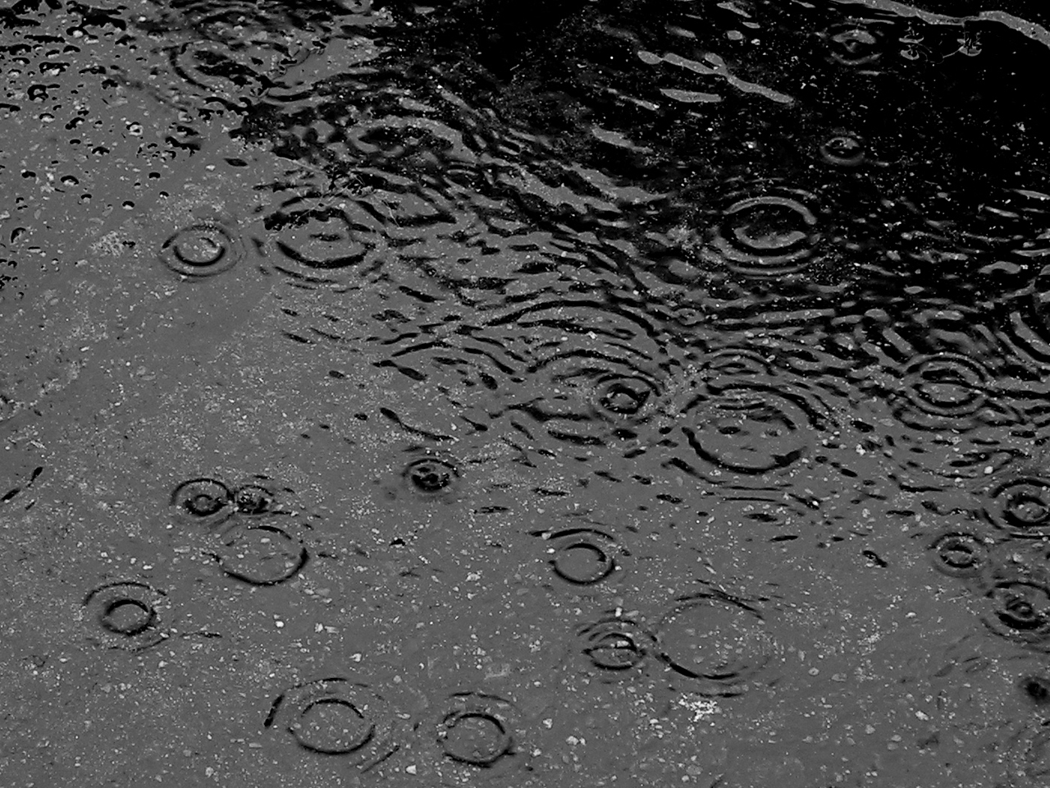
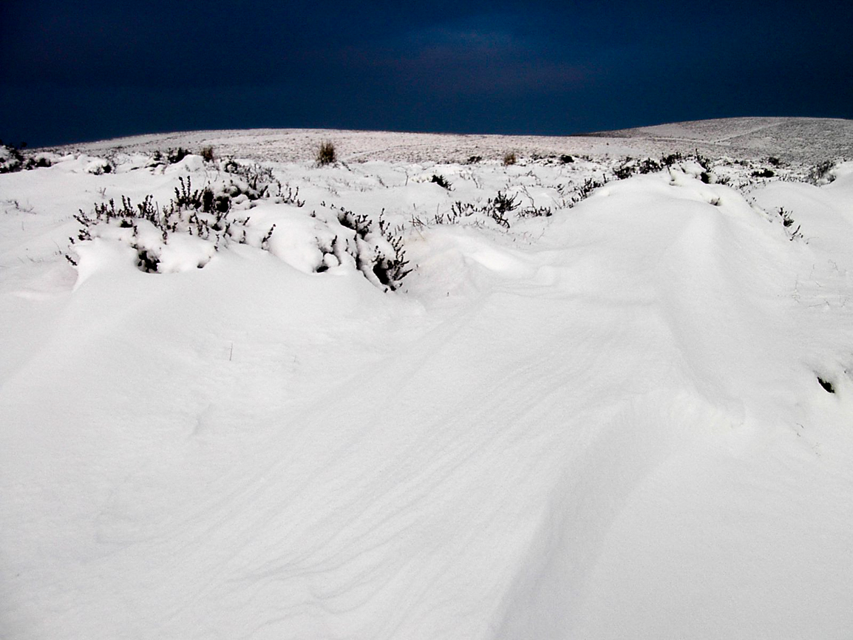
Precipitation Features
Precipitation is measured in mm
We will look at early winter precipitation for year N, full winter precipitation spanning yean N and N+1 , summer precipitation in year N and N+1, and late summer precipitation in year N.
It is thought that high winter precipitation as snowfall insulates the ground which causes a slowing in the refreezing of the active layer
Summer precipitation can increase thawing of permafrost, and add heat into soil.
Notes:
Summer precipitation is rainfall that transfers heat to ground
Winter precipitation is Snow that insulates ground

Slide 24
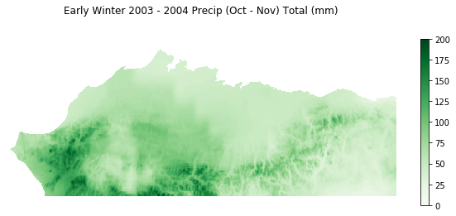
Notes:
Early winter precipitation falls as Snow potentially creating increased insulation early in the season so that ground heat is unable to escape

Slide 25
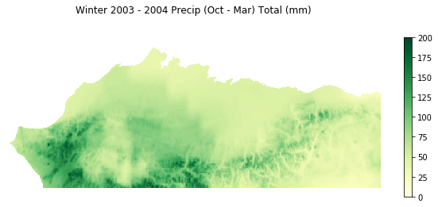
Notes:
winter precipitation falls as Snow potentially creating continued insulation for the entire winter

Slide 26
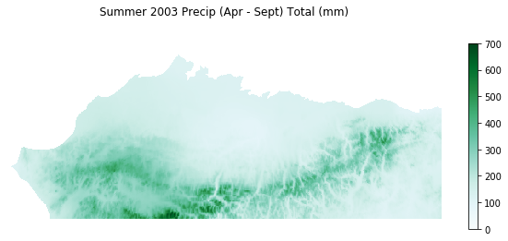
Notes:
Summer precipitation adds heat to the ground, which in summer may increase ALD, or in late summer fall become trapped by winter snows

Slide 27
Features - Air Temperature
Air temperature expressed as freezing degree days (FDD) or thawing degree days (TDD)
Thawing degree days is used to measure summer temperatures
Higher numbers indicate warmer summers (values are > 0)
Freezing degree days is used to measure winter temperatures
Higher numbers indicate warmer winters (values are < 0)
High temperatures can indicate increased thawing in permafrost
We will look at summer temperatures for the year N and year N+1
We will look at winter temperatures for the winter between year N and year N+1
Notes:
High temperatures in summer N indicate increased thawing in permafrost
High temperatures in winter N-N+1 indicate permafrost is unable to freeze again
High temperatures in summer N indicate increased thawing in permafrost, potentially building on previous year
Degree days are the integration of temperature values above or below zero

Slide 28
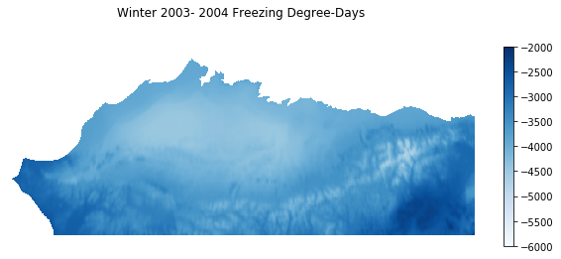

Slide 29
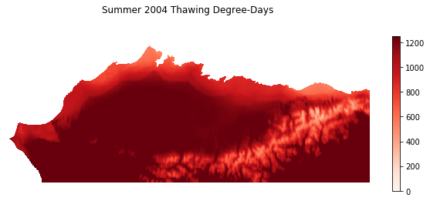

Slide 30
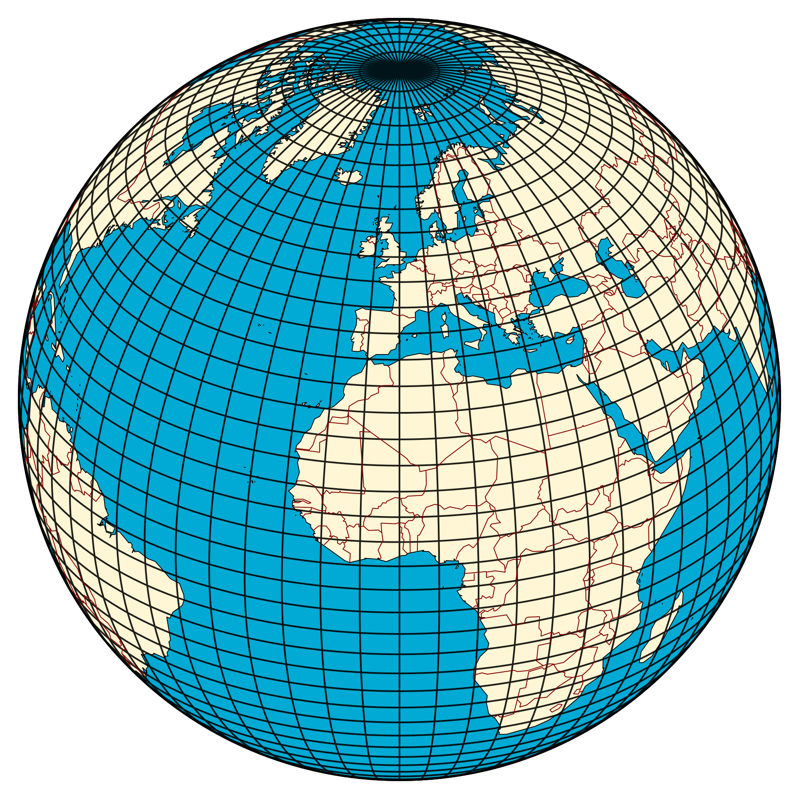
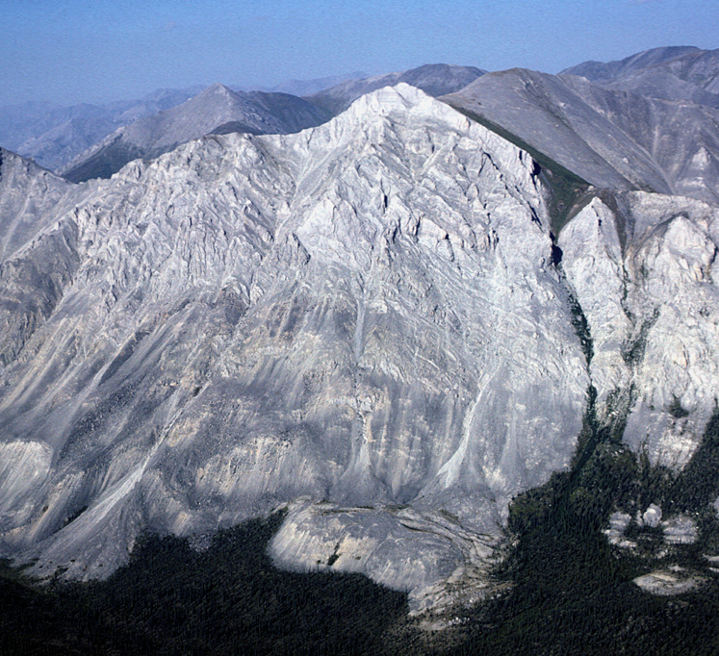
Physical Features
Features of the location of a model grid cell. Theses may effect the result
Latitude, longitude
Elevation
Slope, Aspect
Notes:
How may location influence the thermokarst process
Latitude and longiude are location on globe
Elevation
Slope
Aspect direction of slope

Slide 31
Features - Thermokarst predisposition
Output of thermokarst predisposition model
represents the proportion of the landscape where thermokarst (depression from soil collapse due to permafrost thaw) could initiate and expand under warming climate at a 1km resolution. The general hypothesis underlying the development of this model is that thermokarsts occur in lowland peatland with ice rich permafrost.

Slide 32
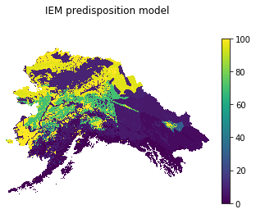
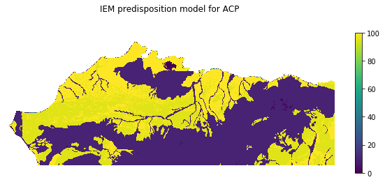

Slide 33
Features - Summary
Previous summer air temperature
Early winter precipitation (Oct-Nov)
Full winter precipitation (Oct-Mar)
Winter air temperature
Summer precipitation (Apr-Sept)
Summer air temperature
Latitude
Longitude
Elevation
Slope
Aspect
Notes:
Summary of the features used for training random forest

Slide 34
Experiment
Develop random forest models using all features described previously, and original thermokarst initiation model.
Develop new model using variables indicated as most important by random forest analysis.
Compare results from original model, random forest results, and new model on a year by year basis to determine how close as a percentage of area new model is to original model
Subtract original model from new model to determine how similar the model predictions are
Notes:
Thresholds
Develop random forest models using all features described previously, and original thermokarst initiation model.
Decide on what is the new model
Compare the results
howclose are the numerical values
how much area is marked as iniation once the thresholds are applied

Slide 35
Tools Used
Python
Numpy
Scipy
Scikit-learn
Random forest regressor.
GDAL and QGIS
Georeferencing and data preparation
Notes:
Use numpy arrays for data representation
Scipy used for find ind TDD and FDD from monthly data (spline function)
Scikit learn random forest regresso used
GDAL and QGIS used in data preparation for georeferening

Slide 36
Scikit-learn Random forest parameters
n_estimators
number of trees in forest
criterion
function to use to measure quality of a split
random_state
seed value for random number generator
max_depth, min_samples_leaf. max_features, max_leaf_nodes
used to control tree size
Notes:
n_estimatiors: number of trees in forest
Criterion: what function to use to detriment quality of each split in trees: Gini impurity or information Gain
Random state: seed used In modles random number generator
max_depth, min_samples_leaf. max_features, max_leaf_nodes: controls tree size
Vary each parameter one at at time to see if results created get better.
Want best results with smallest tree

Slide 37
Reduced Order Model From Random Forest Analysis
Plug the features indicated by random forest model into original method
OR
Iterate on random forest model excluding features that do not contribute to the overall variance
Notes:
How to develop the ROM
Use original model with new features
Iterate on the random forest method

Slide 38
Early Example
Random forest model trained with features described earlier and predictions from original model without predisposition applied
10 estimators
Max leaf nodes set to1000
Used ½ of training data
Notes:
Show some initial images
Show the generated tree

Slide 39
A Tree in the Forest

Slide 40
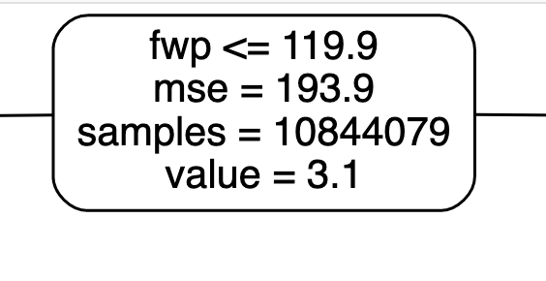
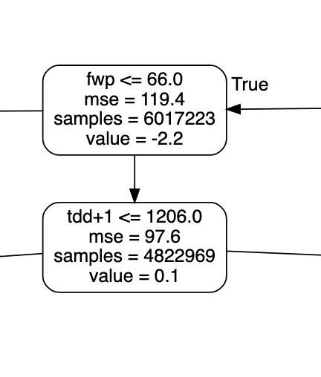
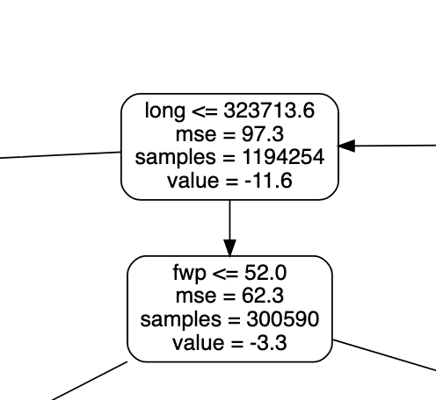
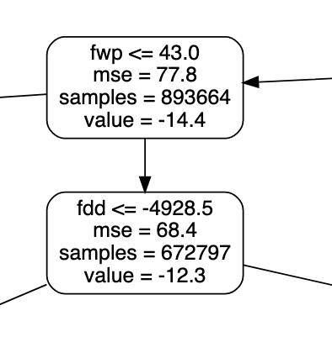
A Tree in the Forest
Root Node
Notes:
If the fwp is less than or equal t0 119.9 go left
If the fwp is less than or equal t0 66 go left
If Longidude is <= 323 thousand go left
If fwp less than or equal 43 go left

Slide 41
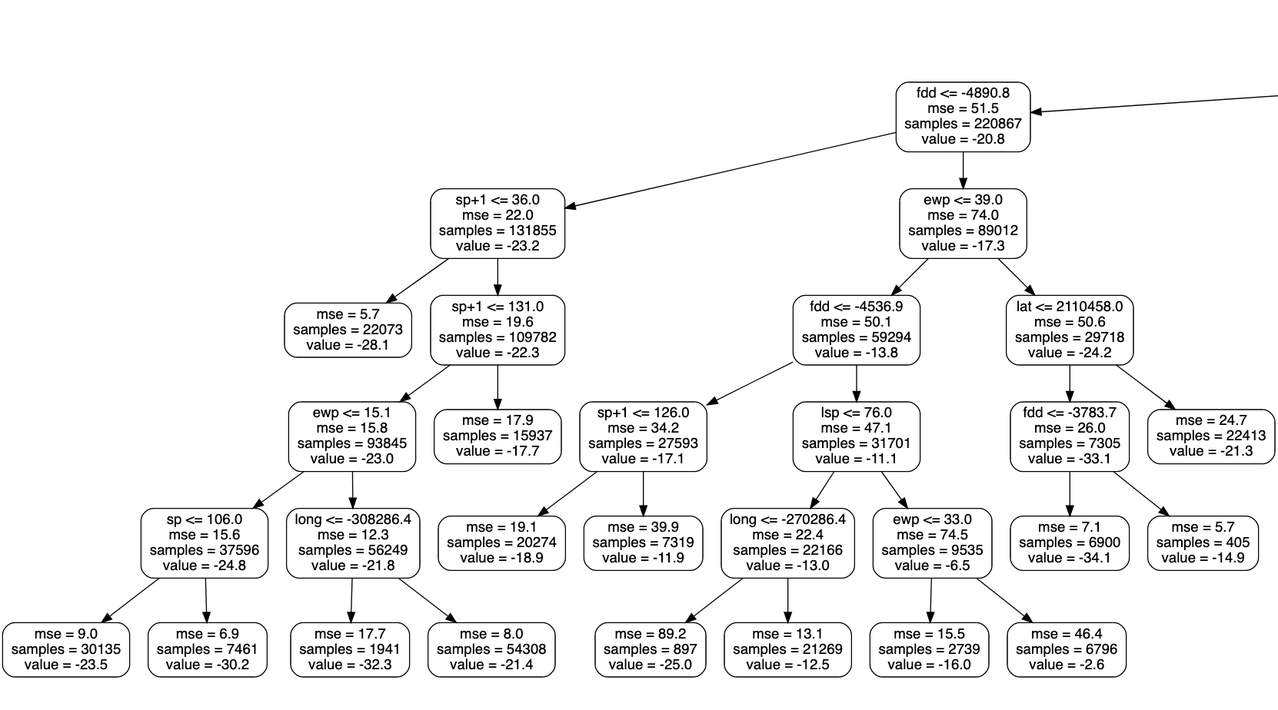

A Tree in the Forest
Notes:
If Fdd less than -4890.8 go left other wise go right
We go right
so if EWP <= 39 go right
Fdd <= -4536
Lsp > 76 go right
Ewp <= 33 go left
Prediction is -16, gets averaged with results from other trees for final answer

Slide 42

A Tree in the Forest

Slide 43
Early Example Feature Importance
Winter temperature: 3.616%
First summer temperature: 4.563%
Second summer temperature: 10.249%
Early winter precipitation: 3.314%
Total winter precipitation: 45.813%
First summer precipitation: 2.271%
Late summer precipitation: 4.254%
Next summer precipitation: 2.481%
Latitude: 11.462%
Longitude: 11.939%
Aspect: 0.0%
Slope: 0.038%
Elevation: 0.0%
Notes:
Total winter precipitation: 45.813% is the larges, followed by lat and long, and second summer precip

Slide 44
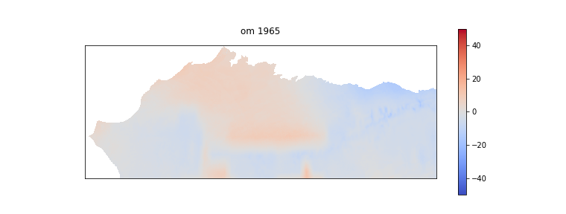
Original Model Prediction for 1965

Slide 45
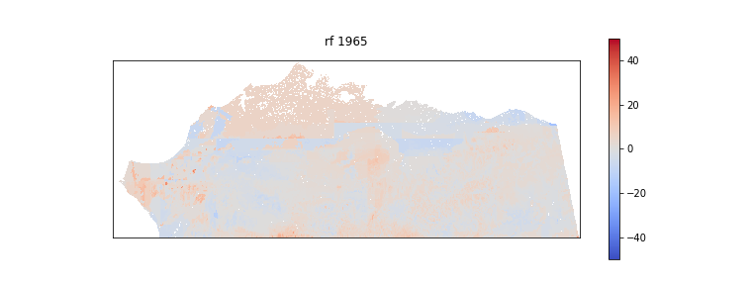
Random Forest Model Prediction for 1965

Slide 46
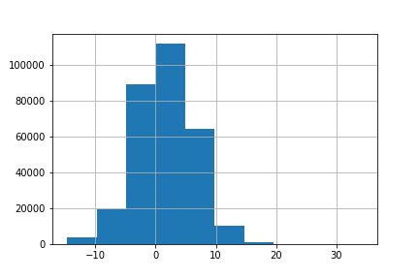
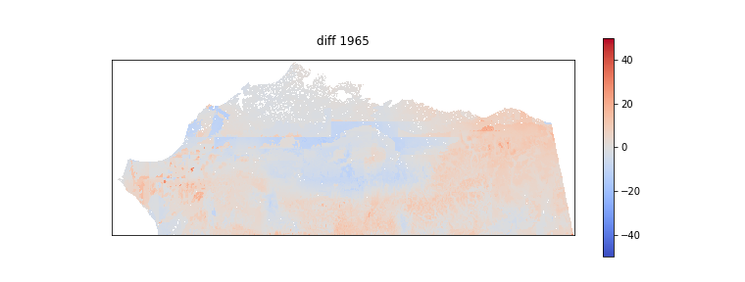
Model Differences for 1965
Map
Histogram

Slide 47
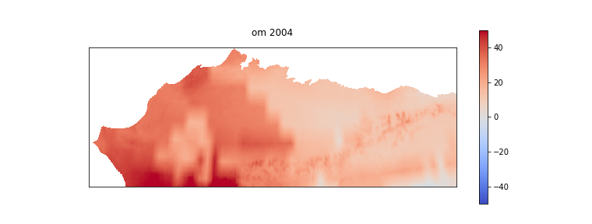
Original Model Prediction for 2004

Slide 48
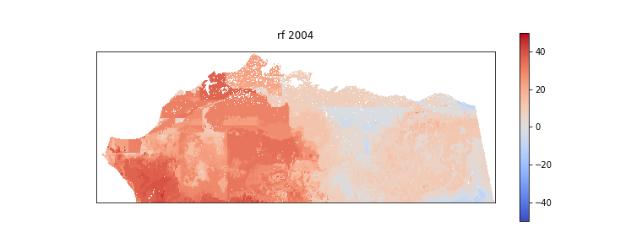
Random Forest Model Prediction for 2004

Slide 49
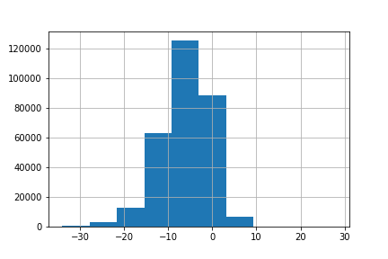
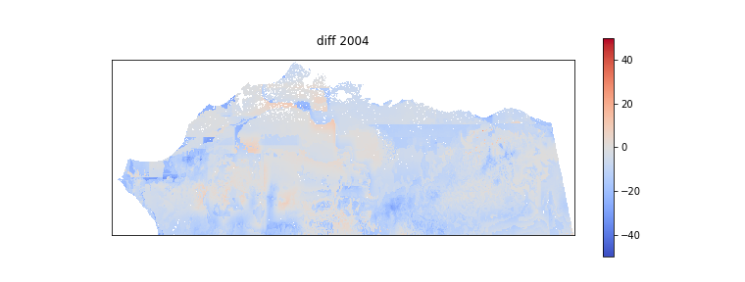
Model Differences for 2004
Map
Histogram

Slide 50
Timeline
Nov 2019
This presentation
Dec 2019 – Jan 2020
Finish project work
Start paper
Feb 2020 – Mar 2020
Finish paper
Final Presentation
Apr 2020
Comprehensive exam
Submit paperwork
May 2020
graduate

Slide 51
Sources
Brown,J., O.J.Ferrians,Jr., J.A. Heginboom, and E.S. Melnikov. 1998, revised February 2001. Circum-arc map of permafrost and ground ice conditions. Boulder, CO: National Snow and Ice Data Center. Digital media.
Jorgenson,T.,K.Yoshikawa, M.Kanevskyi,Y.Shur ,V. Romanovsky, S. Marchenko, G. Grosse, J. Brown, B. Jones. 2008. Permafrost Characteristics of Alaska. Institute of Northern Engineering, University of Alaska Fairbanks, NICOP.
Herman, G.R., Schumacher, R.S. 2018. Money Doesn't Grow on trees but Forecasts do: Forecasting Extreme Precipitation with Random Forests. American Meteorological Society
Hugelius,G.,C. Tarnocai, G.Broll,J.G.Canadell, P.Kuhry, D.K. Swanson. 2013. The Northern Circumpolar Soil Carbon Database: spatially distributed datasets of soil coverage and soil carbon storage in the northern permafrost regions. Earth System Science Data 5: 3–13
Scenarios Network for Alaska and Arctic Planning, University of Alaska. 2019 Historical Monthly Precipitation - 1 km CRU TS - Datasets - SNAP Data Portal . Retrieved 2019-11-04 from http://ckan.snap.uaf.edu/dataset/historical-monthly-precipitation-1-km-cru-ts
Scenarios Network for Alaska and Arctic Planning, University of Alaska. 2019 Historical Monthly Temperature - 1 km CRU TS - Datasets - SNAP Data Portal. Retrieved 2019-11-04 from http://ckan.snap.uaf.edu/dataset/historical-monthly-temperature-1-km-cru-ts
Scenarios Network for Alaska and Arctic Planning, University of Alaska. 2019. Thermokarst Formation - Datasets - SNAP Data Portal. Retrieved 2019-06-21 from http://ckan.snap.uaf.edu/dataset/thermokarst-formation.

Slide 52
Other sources
https://www.sciencedirect.com/topics/earth-and-planetary-sciences/thermokarst
https://en.wikipedia.org/wiki/Random_forest
https://en.wikipedia.org/wiki/Bootstrap_aggregating
https://scikit-learn.org/stable/modules/ensemble.html#forest
https://scikit-learn.org/stable/modules/generated/sklearn.ensemble.RandomForestRegressor.html#sklearn.ensemble.RandomForestRegressor
https://towardsdatascience.com/decision-trees-in-machine-learning-641b9c4e8052
https://en.wikipedia.org/wiki/Decision_tree_learning
Other images from wikipedia

